Slide 1
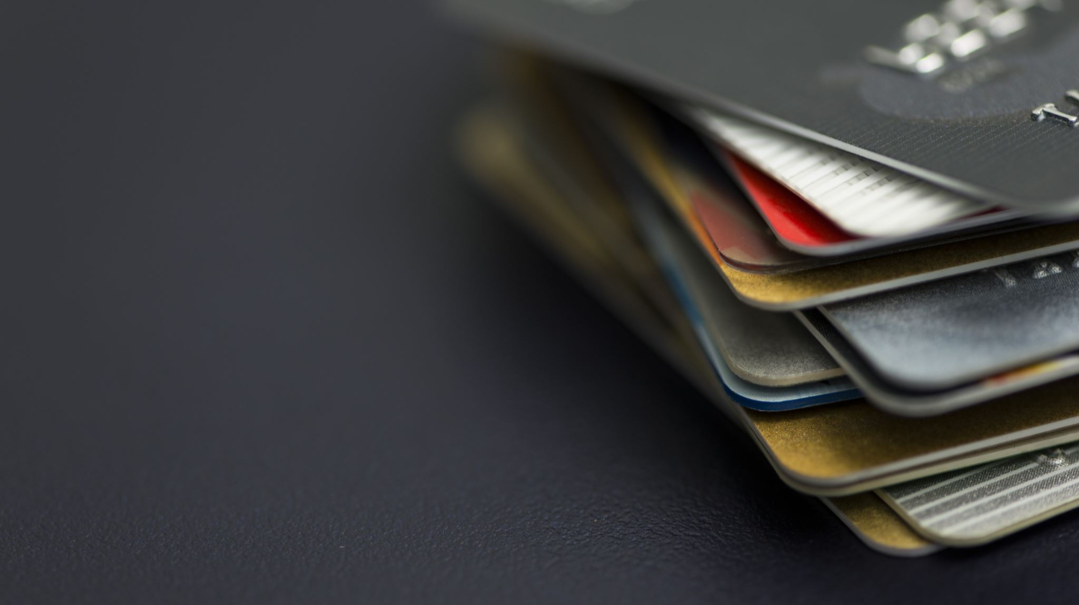
Credit Card Fraud
Kevin

Slide 2
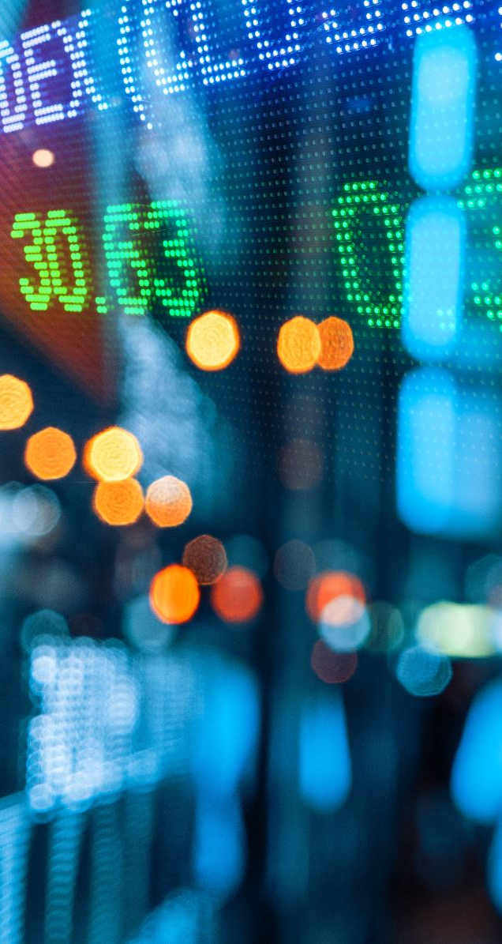
Why Should You Care?
Consumers reported losing nearly $8.8 billion to Scams in 2022
Credit card fraud worldwide will reach $43 billion by 2026
48% of consumers say it’s the merchant’s responsibility to protect them from fraud
Notes:
Why should you care?
According to the FTC, consumers reported losing almost 8.8 billion to scams in 2022
Credit card fraud worldwide will reach 43 billion by 2026
Merchantcostconsulting half of customers say it’s the merchant’s responsibility to protect them from fraud

Slide 3
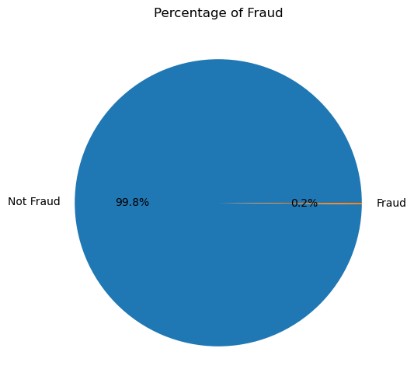
The Data - at a Glance
284 807 Transactions over 2 days
$60 127.97 were lost due to fraud
$11 million per year
Notes:
Got data from Kaggle
Distribution of Fraud is on the pie
0.2 X 0.17%
Why should you care?
Data collected over two days
In that time 280 000 transactions completed
In that time 60 000 dollars were lost due to fraud
A calculator tells us that 11 million annually.

Slide 4

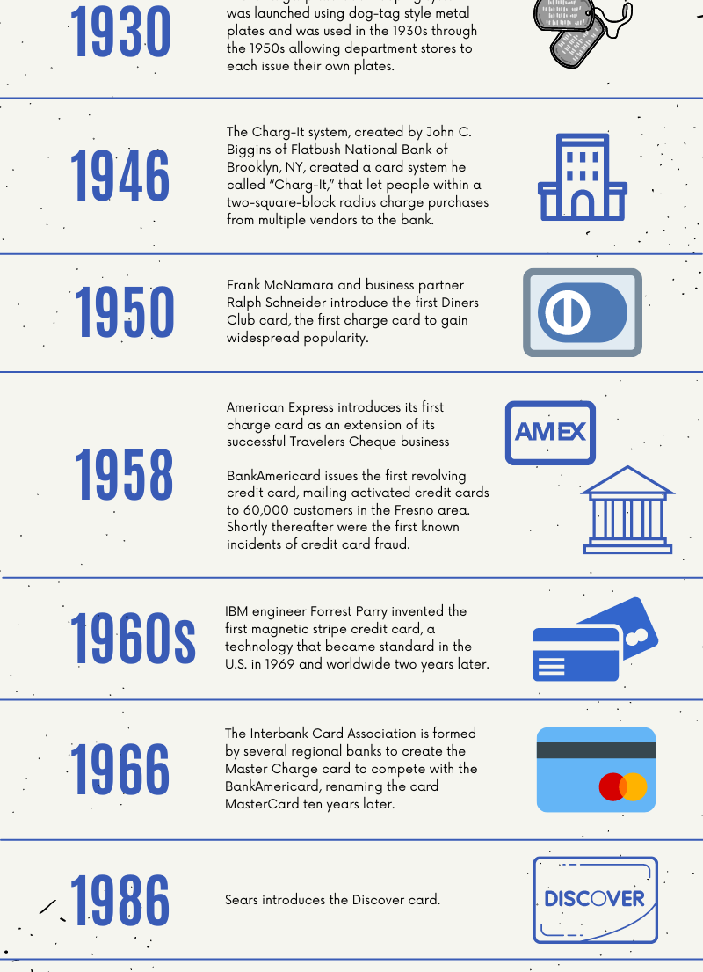
Background - History
1958 BankAmericard later Visa was first introduced, fraud followed shortly
2 Broad Types, Card-Present and Card-not-present
Card-Present Fraud occurs when the card is lost, stolen, intercepted, or counterfeited.
Physical card has had decades for safe
Digital Age: Physical cards not required.
At least 70% of fraud is now Card-not-present
Notes:
Let’s give a background
All know credit card
Let’s jump back to 1950s. There were some precursors to the credit card, called diner club cards
1958 BankAmericard (Visa) first introduced their credit card shortly thereafter the first credit card fraud.
In those days Card-Present Fraud was the only type of fraud.
This type happens when the card is lost, stolen, intercepted, or counterfeited
Credit card companies have had decades to adapt, kinda safe
Now technology is expanding at a rate difficult to regulate
Fraud has shifted from card present to card not present, at least 70%

Slide 5
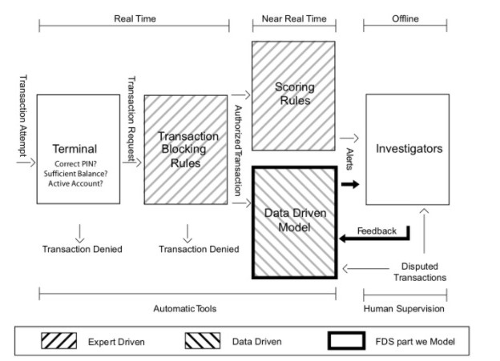
Background - Process
Terminal
Checks PIN
Checks Card Number
Transaction Blocking Rules
Simple rules
Scoring Rules
Complex
Determined by Expert
Data Driven Model
Notes:
So how do we stop fraud?
The first stop is at the Terminal
Checks PIN, Checks Card number, Checks Code
Bypassed by those super annoying phishing emails
Next, Transaction Blocking Rules
Typically simple rules like checking to see if it’s an unsecure website or if the address is in the ocean.
Now you have Scoring Rules and a Data Driven Model.
Scoring Rules are a conjunction of things indicating possible fraud
For instance if the account is registered in China but requesting a ride in LA SUS or address is in a block with other fraudulent accounts SUS
But These are Expert driven models. The scores the likelihood is kind of arbitrary not no logic but up to expert.
In Modern Day Technology and what I’m presenting is the Data Driven Models.
These models look at the data we have and make informed decisions themselves.
If they’re neural networks, they will even learn themselves.

Slide 6
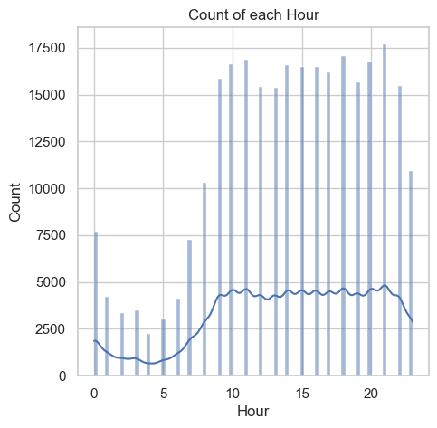
The Data - Summary
284 315 genuine transactions
492 cases of fraud
PCA transformed columns
Time Column
Seconds since start
Transformed to Hours
Amount Column
Min 0
Max 25 691
Median is $ 22
Fraud median $ 9.25
Notes:
It has specifically 284 315 genuine transactions 492 cases of fraud
There were no missing values in the dataset
And had the following Columns: Time, Amount, Class (Fraud/not), and 28 PCA transformed columns
I have no idea what they were since they were, for privacy reasons hidden.
The time column was the time in seconds from the start of the data collection period to the end.
I transformed that into the Hours format representing the hours of the day so it’s more usable.
The Amount column ranged from 0 to 26000
The median is only 22 and the median for fraud is 9.25

Slide 7
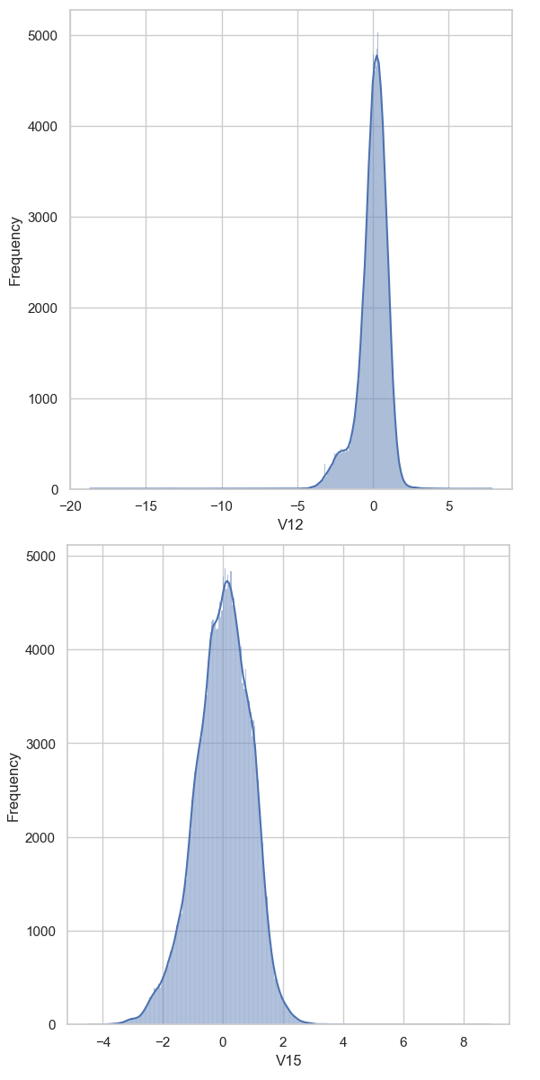
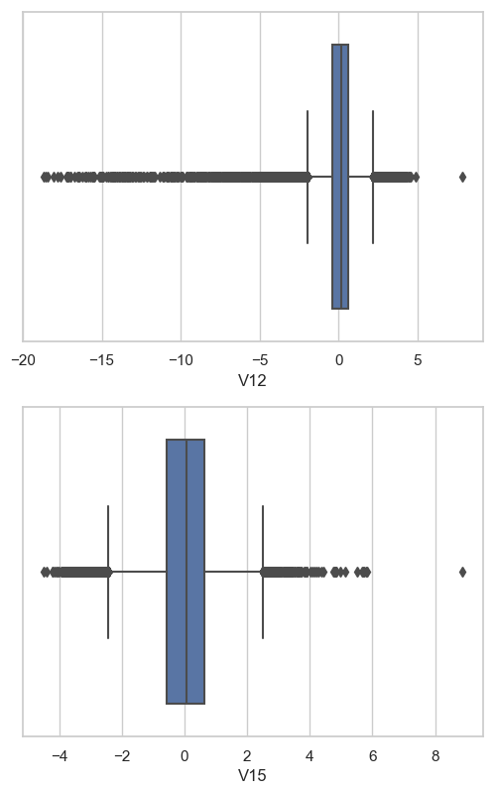
The Data - Distributions
High in Kurtosis
Many outliers
Extreme outliers
Time was bimodal
Amount wasn’t normally distributed
Robust Scaler
Notes:
Looking at the Distribution of the Data
A sample of the data most graphs look like the two pairs here, time and amount were exceptions
We can see its high in Kurtosis meaning its outliers are going to be extreme and we can also find it has Many outliers
Does look kind of normal already, but because of the outliers we use robustscaler
Normally I like to clip the outliers, but I didn’t this time because it would affect 40% of the minority class

Slide 8
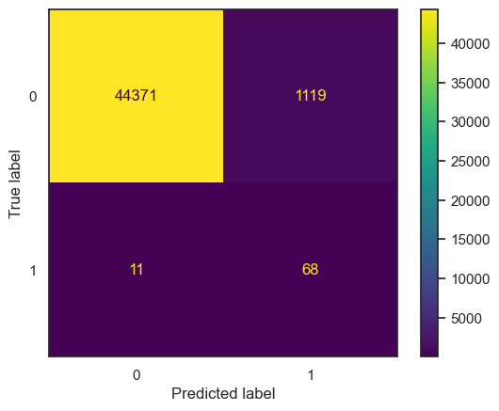
Baseline Model
Log Regression
ROC AUC 0.918
Recall of 0.86
Precision of 0.06
Metric of Choice was ROC AUC
Notes:
Log Regression
ROC AUC 0.918
Recall of 0.86
Precision of 0.06
Metric of Choice was ROC AUC because it was the most widely used method for Credit Card fraud detection
Precision so low, it’s a problem
Customers are going to have complaints and there’s a lot of unnecessary work

Slide 9
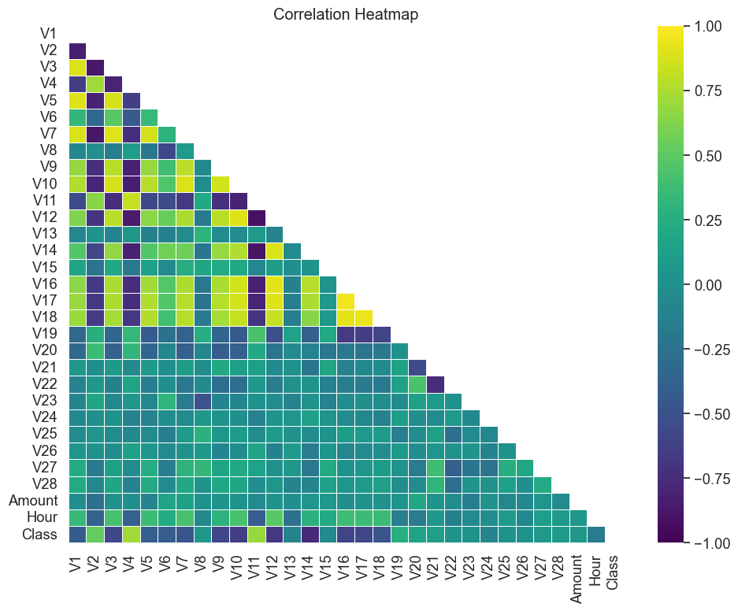
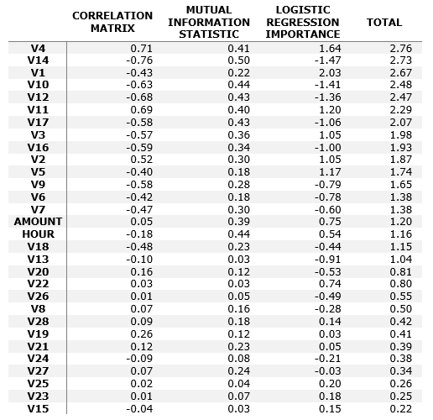
Feature Selection
Notes:
First thing is a bit of feature selection
Mutual Information Statistic
Logistic Regression Coefficients
Correlation Matrix
I took the absolute values, added them up and sorted them.
Then I took the features that had a sum greater than 1.

Slide 10
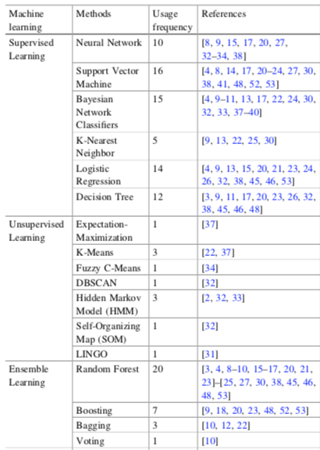
Methods of Choice
Logistic Regression and Decision Tree for simplicity.
Support Vector Machine and Random Forest since they’re widely cited
XGBoost and Neural Networks for their power
Notes:
Better models.
Logistic Regression is quick so I used it as baseline.
Also took a look at Decision Tree since it’s simple.
I wanted to use SVM since it’s second most widely used, but it is so slow I can’t.
XGBoost and Neural Networks I did use.

Slide 11

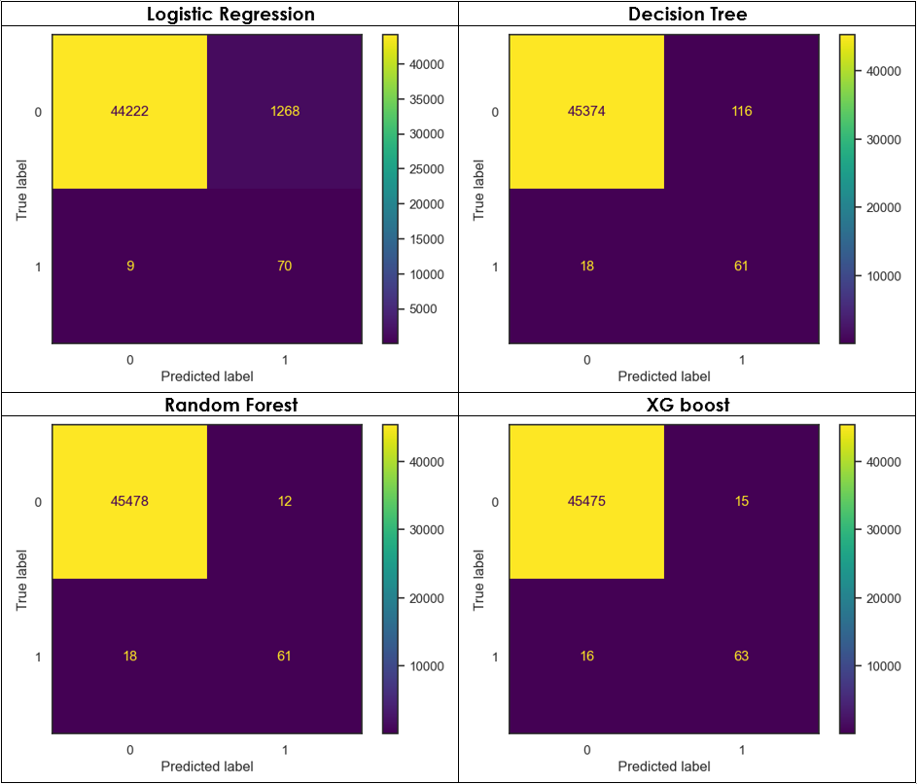



Algorithm Selection
Logistic Regression: 0.929
Decision Tree: 0.885
Random Forest: 0.886
XG Boost: 0.899

Slide 12
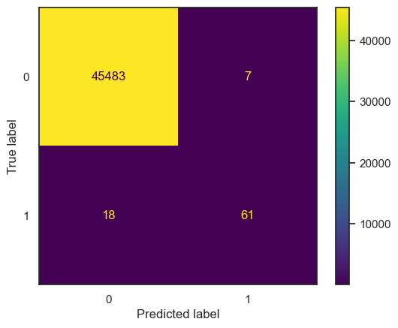
Model Stacking
Logistic Regression + Random Forest + XGBoost
ROC AUC: 0.886

Slide 13

Deep Learning
Feedforward Neural Network
3 hidden layers
Input layer had 512 neurons; hidden layers had decreasing amounts
Output was sigmoid activation due to binary classification
Higher ROC AUC: 0.917, lower precision.

Slide 14
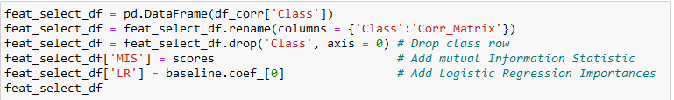

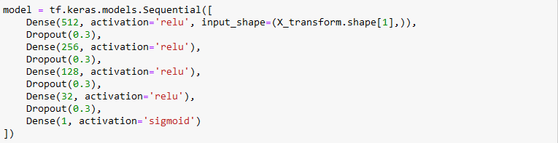
Code Highlights
Hour Feature
Combining the Feature Selection
Grid search
Deep Learning Model
Notes:
Some Code I want to highlight:
Hour Feature

Slide 15

Final Model
XGBoost
Default Hyperparameters
ROC AUC of 0.923
Customer Satisfaction: Stacked Model
Employee Workload: Deep Learning

